Slide 1

Department of Computer Science Gujarat University
5 Year Integrated M.Sc.(Computer Science)
Semester – V
ATM & Banking Services
Presented By:
Lamin Janka(50021)
Mohit Jariwala(12)
Under the Guidance of :
Dr. Hardik Joshi

Slide 2
Introduction
The ATM and Bank Management System is a Java application that helps manage banking tasks, both for customers and bank. It allows customers to perform actions like checking their balance, withdrawing money, and making deposits through an ATM. For bank staff, it provides tools to manage customer accounts and transactions.
The system uses secure Card Number and PIN authentication to protect user accounts, and it keeps records of all transactions for future reference. It is designed to be user-friendly, secure, and efficient, ensuring smooth ATM and banking operations for both users and administrators.

Slide 3
Objectives
Efficient Banking System:
Develop a robust banking system to manage customer accounts, including opening, closing, and updating account information.
ATM Operations:
Enable seamless ATM functionalities like balance inquiry, cash withdrawal, and deposits for customers, providing a smooth and secure banking experience.
Security and Authentication:
Ensure user authentication through secure PIN-based login for ATM users and admin access for bank staff, using encryption for sensitive data.
Transaction Management:
Accurately manage and record all transactions (withdrawals, deposits, balance checks) with real-time updates and logs.
User-Friendly Interface:
Provide an intuitive and easy-to-use interface for customers using the ATM, as well as a back-end system for bank staff to manage accounts and transactions.
Transaction History and Logging:
Maintain a detailed log of all transactions, allowing users to review past transactions and ensuring traceability for auditing purposes.
Role-Based Access Control:
Implement role-based access to differentiate between ATM users, bank administrators, and staff, ensuring appropriate access to features and data.

Slide 4
Project Profile
Title | Description
Project title | Online Examination System
Aim of project | This project intends to create a system that is easily accessible and provides the user with a secure and feasible environment for conducting and appearing for his/her examinations. It also aims to revolutionize the traditional assessment system.
Project duration | 6 months
Team size | 4 members
Team Members | Lamin Janka(16) , Parin Makwana(17) , Juhi Modi(20), Ishika Thakkar(111)
Tools and technologies to use | XAMPP , PHP, JavaScript, HTML, CSS, Visual Studio Code
Guide | Dr Maitri Jhaveri
Title | Description
Project title | ATM & Banking Services
Aim of project | The ATM & Banking Management System is designed to simulate real-world banking operations and ATM functionalities, including customer account management, balance inquiry, money withdrawal, deposit, and statement generation.
Project duration | 6 months
Team size | 2 members
Team Members | Lamin Janka(16) & Mohit Jariwala(12)
Tools and technologies used | Java(Swing)
Guide | Dr. Hardik Joshi

Slide 5
Tools, Technologies & Software’s Used
Programming Language:
Java
Database:
MySQL
Development Tools(IDE):
Visual Studio Code
IntelliJ
Libraries/Frameworks:
JDBC
Java Swing
Encryption:
Standard encryption methods for securing sensitive data like PINs
Operating System:
Windows (for development and testing)

Slide 6
Work Division
Name | Work
Mohit Jariwala | GUI Core System Development Security and Authentication
Lamin Janka | GUI Database Management Testing and Debugging

Slide 7
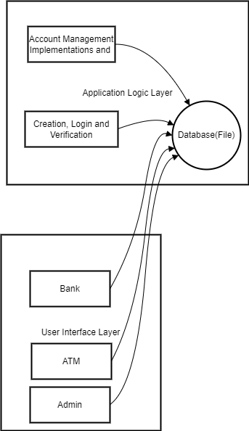
System Architecture
MySQL

Slide 8
Activity Diagram

Slide 9
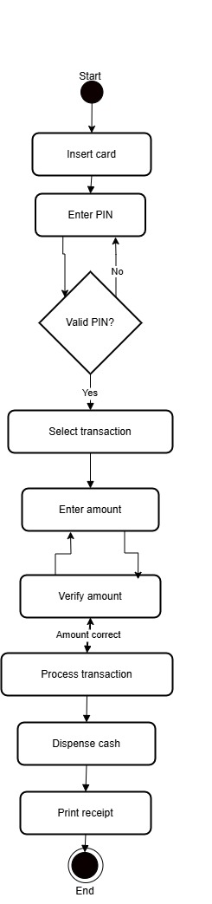

Slide 10
Flowchart

Slide 11
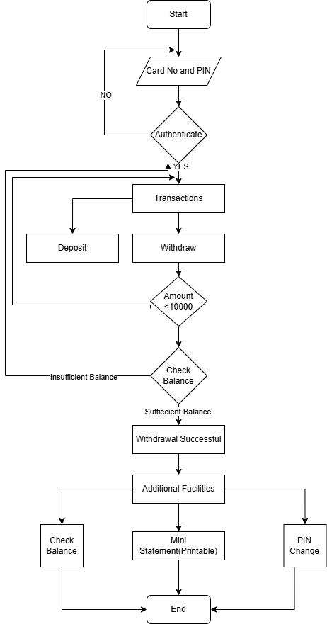

Slide 12
Data Flow Diagrams

Slide 13
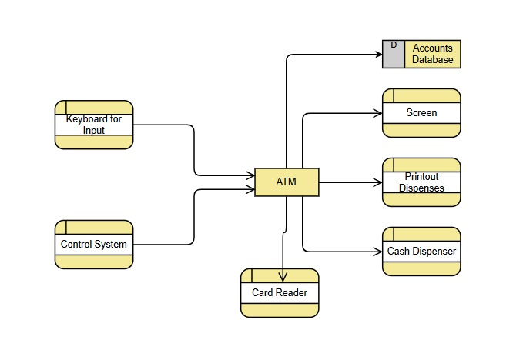
Level 0 DFD

Slide 14
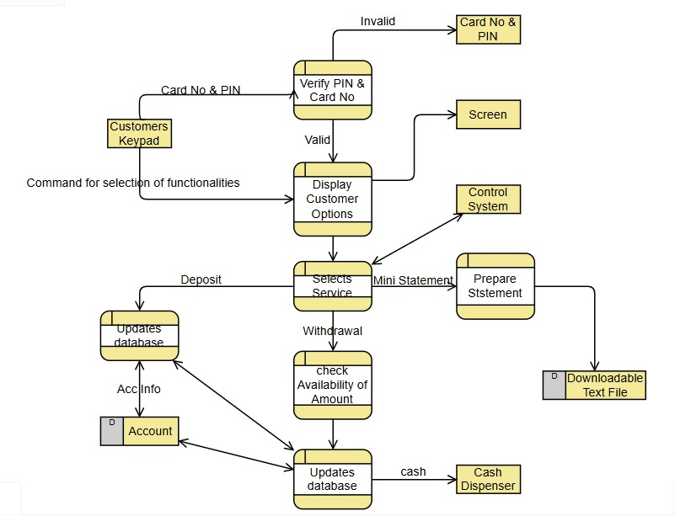
Level 1 DFD

Slide 15
Database Design

Slide 16
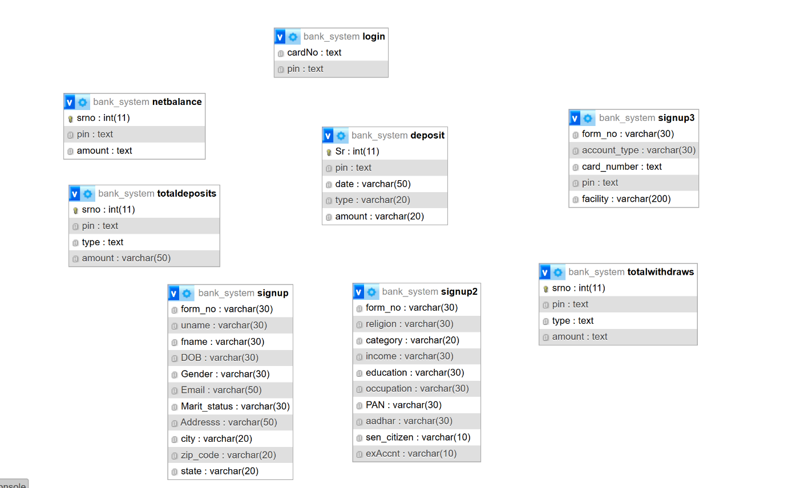

Slide 17
Data Dictionary

Slide 18
Deposit
Column | Type
Sr | Int
pin | Text
date | Varchar(50)
type | Varchar(20)
amount | Varchar(20)

Slide 19
Sr | Pin | date | type | amount
1 | cf866614b6b18cda13fe699a3a65661b | Fri Oct 18 23:11:51 IST 2024 | DEPOSIT | 5000.00
2 | cf866614b6b18cda13fe699a3a65661b | Tue Oct 22 20:17:02 IST 2024 | DEPOSIT | 2000.00
12 | cf866614b6b18cda13fe699a3a65661b | Wed Oct 23 00:00:38 IST 2024 | WITHDRAWAL | 450.00
13 | 122e27d57ae8ecb37f3f1da67abb33cb | Wed Oct 23 00:02:39 IST 2024 | WITHDRAWAL | 300.00

Slide 20
Login
Column | Type
card | text
pin | Text

Slide 21
card | Pin
4567890123456789 | 3b712de48137572f3849aabd5666a4e3
4496729582401836 | 122e27d57ae8ecb37f3f1da67abb33cb
9168427588269011 | 1ce3e6e3f452828e23a0c94572bef9d9
5813956490174441 | cf866614b6b18cda13fe699a3a65661b

Slide 22
Netbalance
Column | Type
Srno | Int
pin | Text
amount | Text

Slide 23
Srno | pin | amount
4 | cf866614b6b18cda13fe699a3a65661b | 7600.0
5 | 122e27d57ae8ecb37f3f1da67abb33cb | 39800.0

Slide 24
Totaldeposits
Column | Type
Srno | Int
pin | Text
type | Text
amount | Varchar(50)

Slide 25
Srno | Pin | type | amount
3 | cf866614b6b18cda13fe699a3a65661b | DEPOSIT | 8500
8 | 122e27d57ae8ecb37f3f1da67abb33cb | DEPOSIT | 65600
9 | b53477c2821c1bf0da5d40e57b870d35 | DEPOSIT | 9050

Slide 26
Totalwithdraws
Column | Type
Srno | Int
pin | Text
type | Text
amount | Text

Slide 27
Srno | Pin | type | amount
4 | cf866614b6b18cda13fe699a3a65661b | WITHDRAWAL | 900
5 | 122e27d57ae8ecb37f3f1da67abb33cb | WITHDRAWAL | 25800

Slide 28
Use Case Diagram

Slide 29
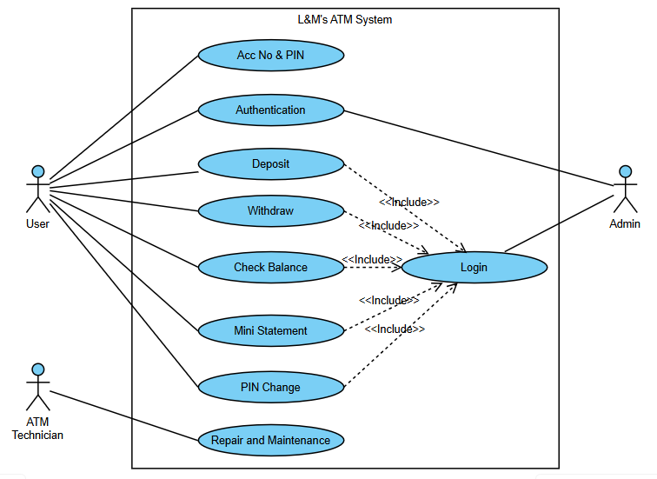

Slide 30
Snapshots

Slide 31
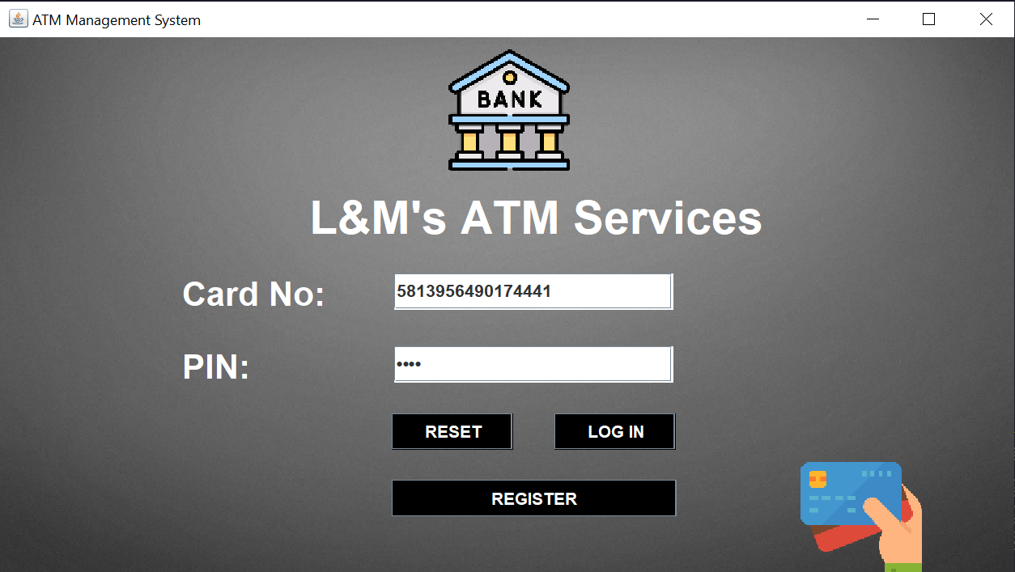
Login Page

Slide 32
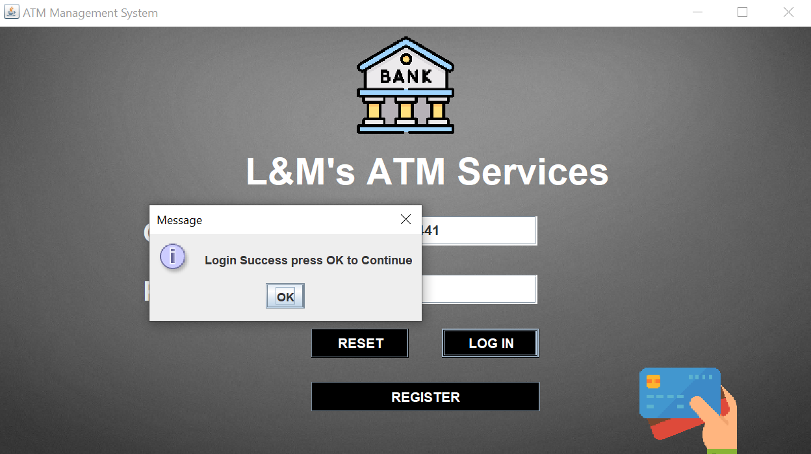

Slide 33
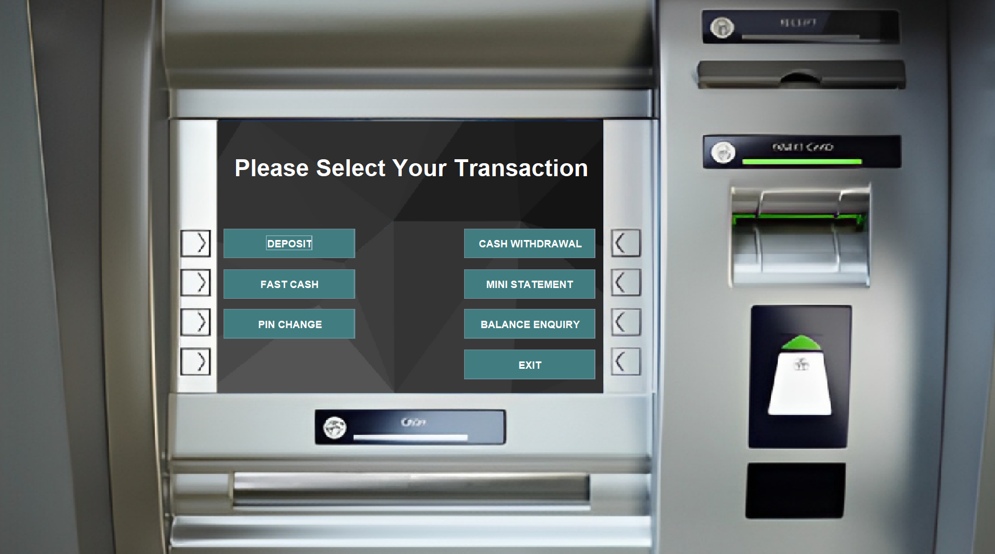
ATM Main Interface

Slide 34
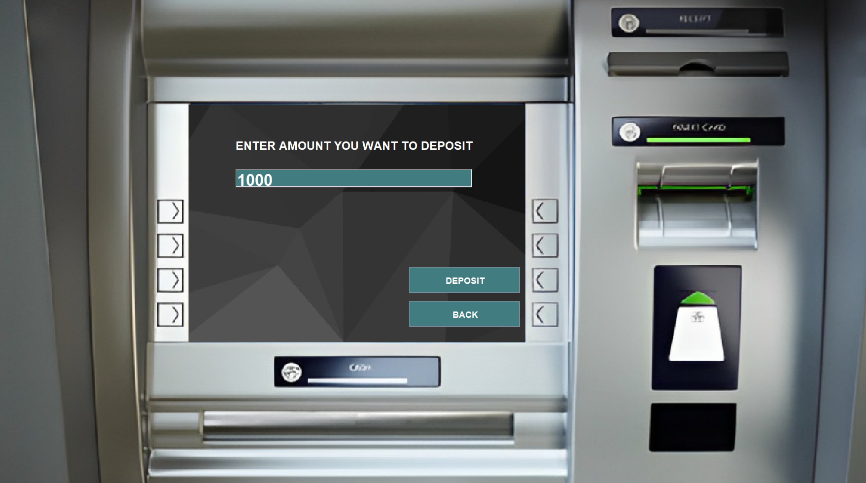
Deposit

Slide 35
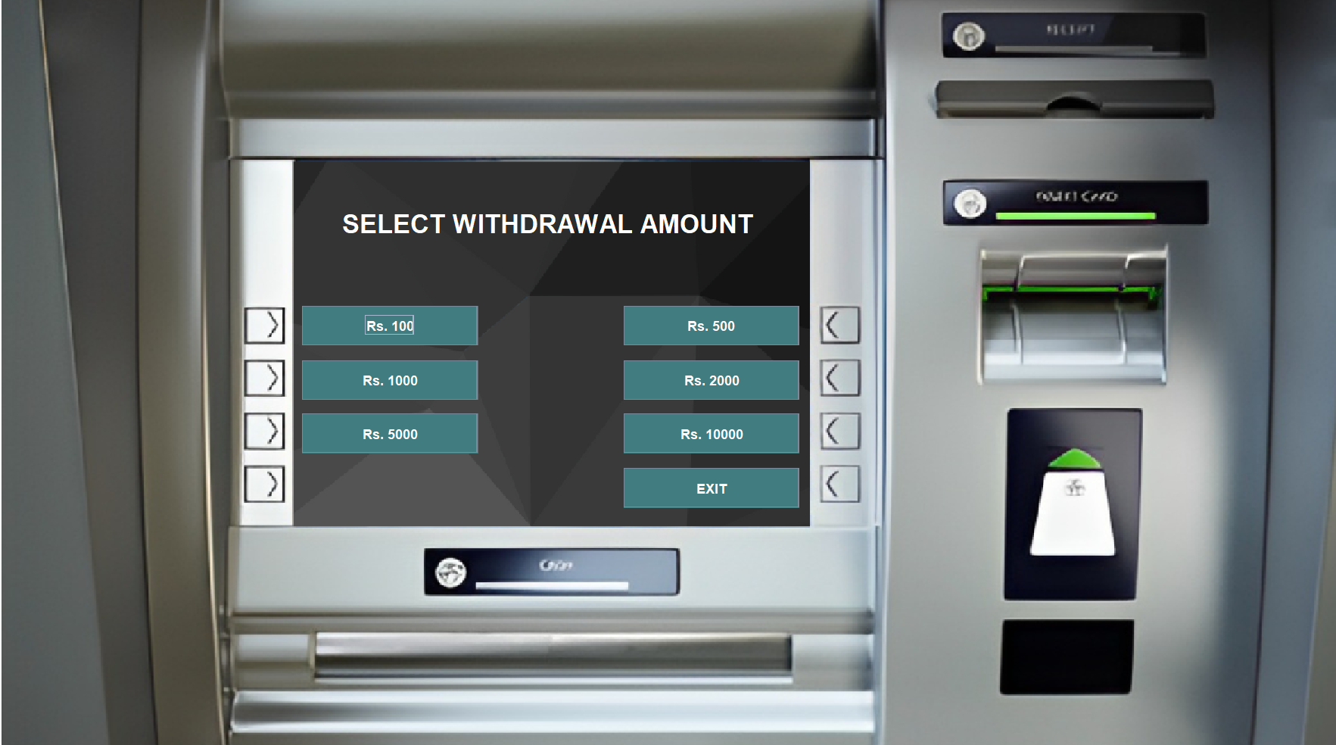
Fast Cash

Slide 36
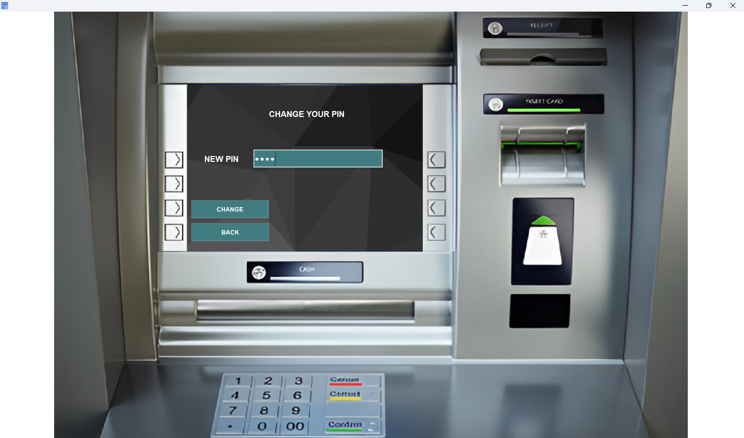
PIN Change

Slide 37
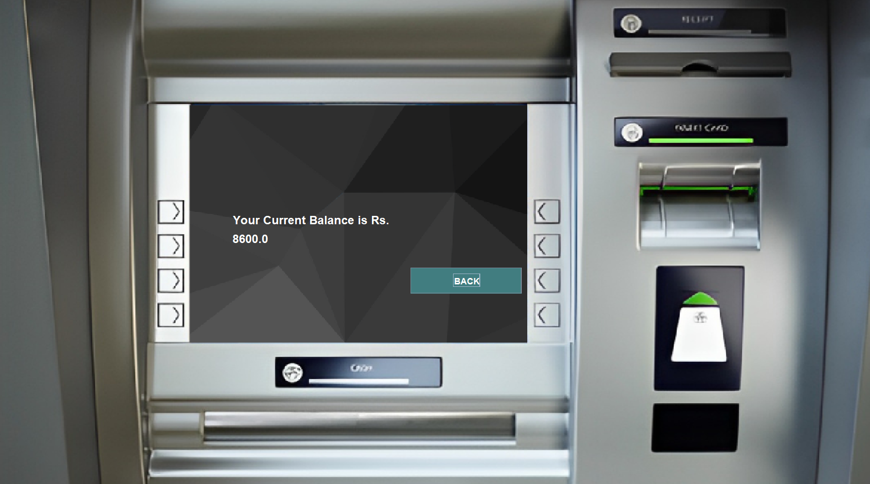
Balance Enquiry

Slide 38
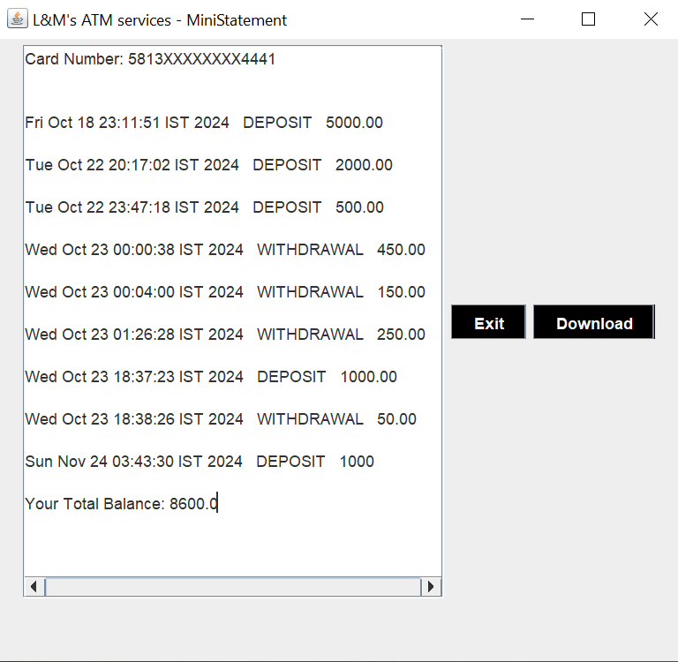
Mini Statement

Slide 39
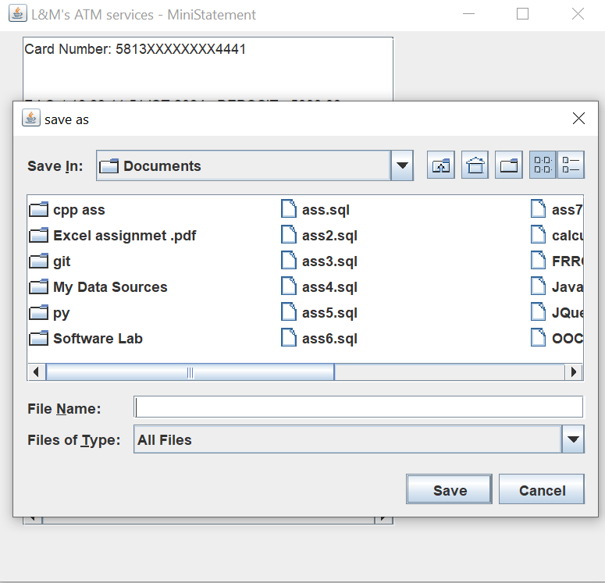

Slide 40
Future Work
Multilanguage Support
Implement support for multiple languages to cater to a diverse user base.
In-App Feedback Forms
Implement forms within the application to allow users to submit feedback easily.
Fund Transfers
Enable users to transfer funds between accounts and to other banks
Bill Payments
Integrate bill payment features for utilities, loans, and other recurring payments.

Slide 41
Bibliography
Reference Websites
Diagram illustrations
draw.io
visualparadigm-online
Image Template
Freepik.com

Slide 42
MERCI!!

